Slide 1
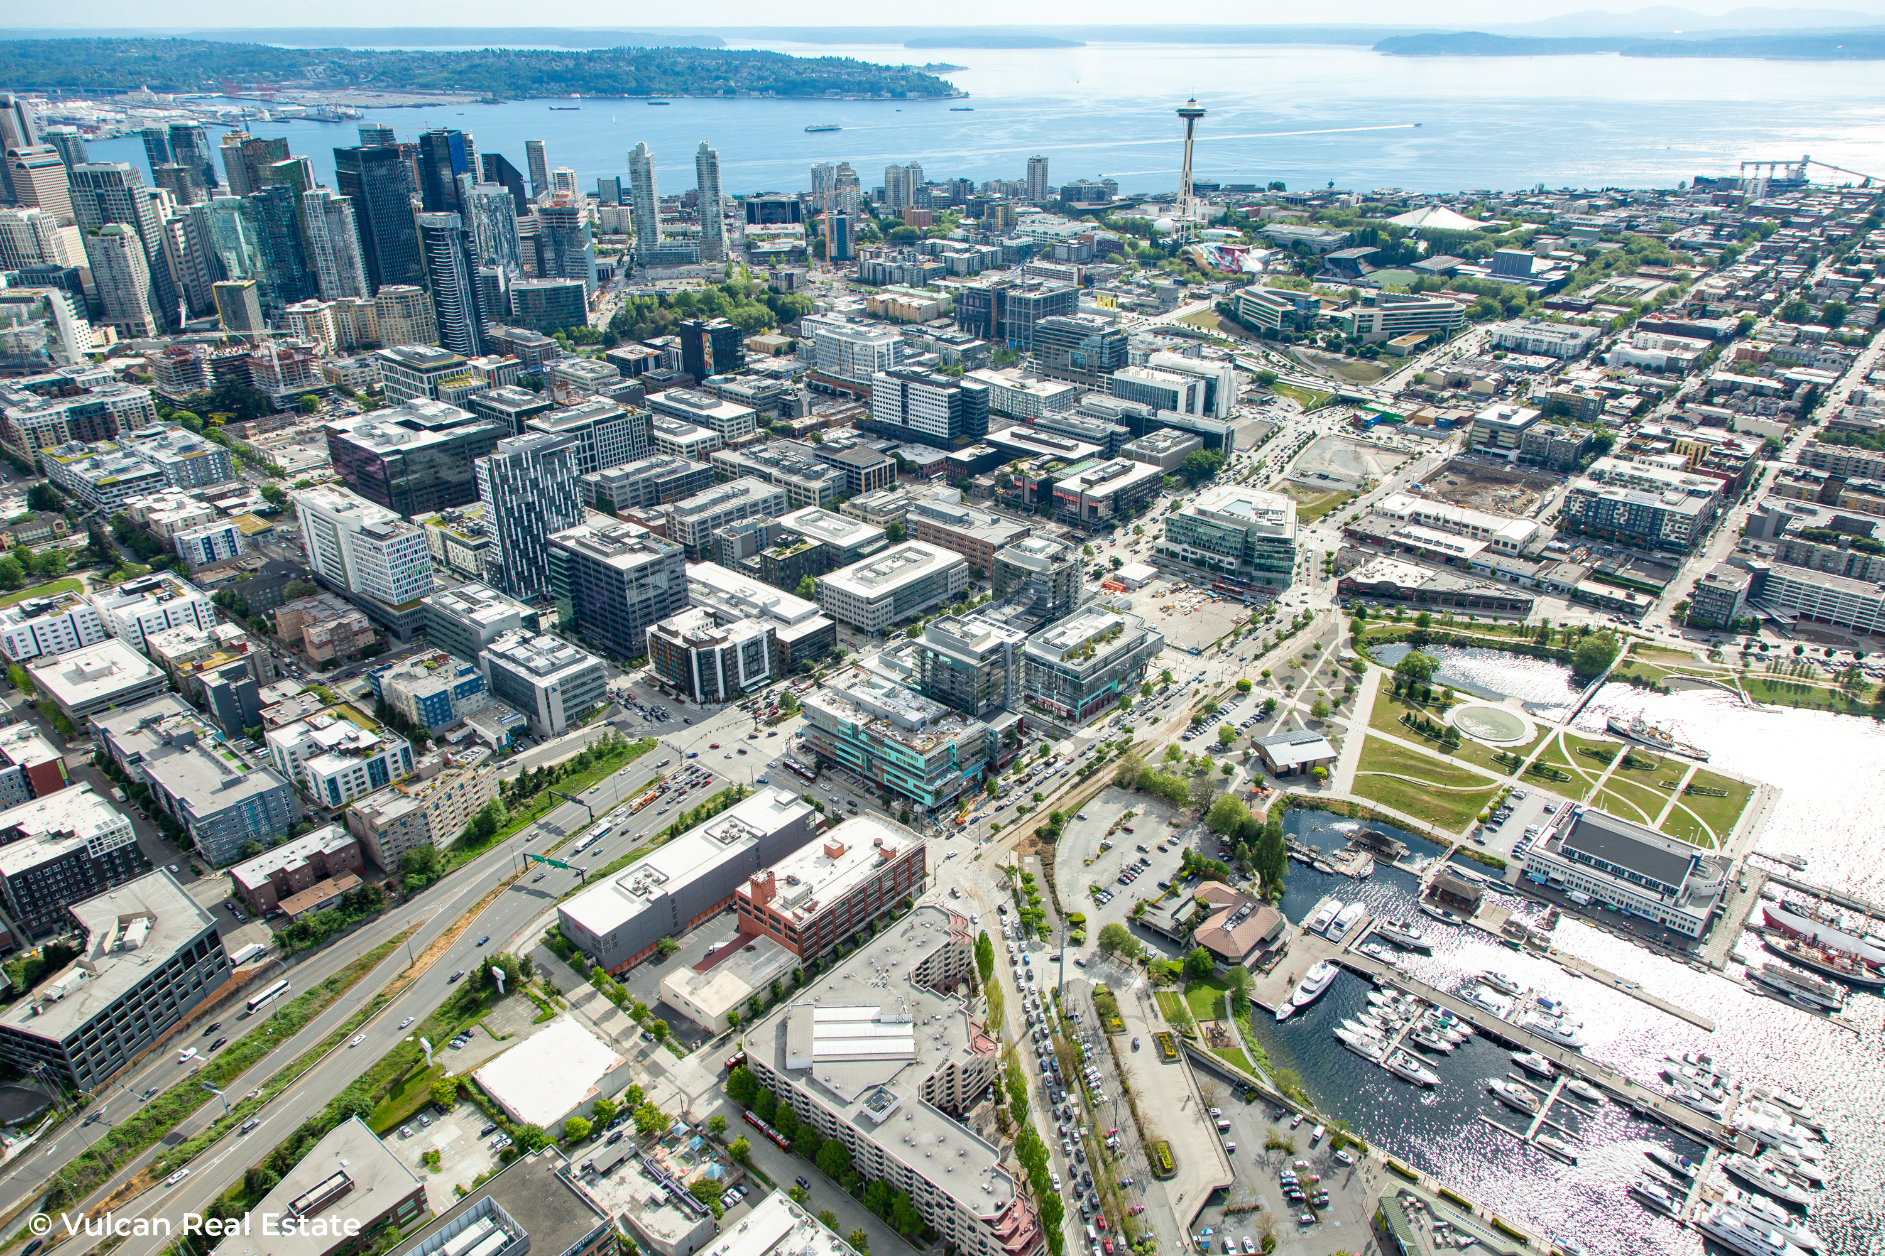
Mercer Corridor Stakeholder Committee
April 30, 2020

Slide 2
AGENDA
Overview of Mercer Corridor Stakeholder Committee (MCSC) origins, history, and future
Mercer Stakeholders position on original Sound Transit (ST3) plan
DSA principles for new Sound Transit line
Group discussion about MCSC principles and issues
Next steps
Notes:
Good morning everyone, and welcome to our first Mercer Corridor Stakeholder meeting of the near decade.
I hope you are all doing well working from home and staying safe.
We started planning in January to re-invigorate the Mercer Stakeholders, and decided a few weeks ago that we just can’t wait to get us all together, so we hope this virtual format works for now.
We have invited many new entities to join our group. And rather than having you all verbally introduce yourselves, I ask that you use the “Chat” button and tell everyone who is here with your name and organization.
If you have questions during our presentation, please use the “Raise Hand” button or use the chat to send us a questions and we’ll try to respond as we go.

Slide 3
MCSC History: Mercer Street Projects
Started in 2006 as an ad-hoc neighborhood committee to influence SDOT about Mercer East Project
Included 36 stakeholders from wide variety of interests extending from Magnolia to I-5
Reached consensus on a package of recommendations in September 2006 that extended to Mercer West and SR 99
Supported two successful federal (TIGER) grants for project
All but one of the recommendations was incorporated into the various projects
Notes:
For all of you that are new to our group, or even if you haven’t been here since the beginning, I wanted to do a brief recap of everything that the Mercer Stakeholders have accomplished in the 14 years since we first convened.

Slide 4
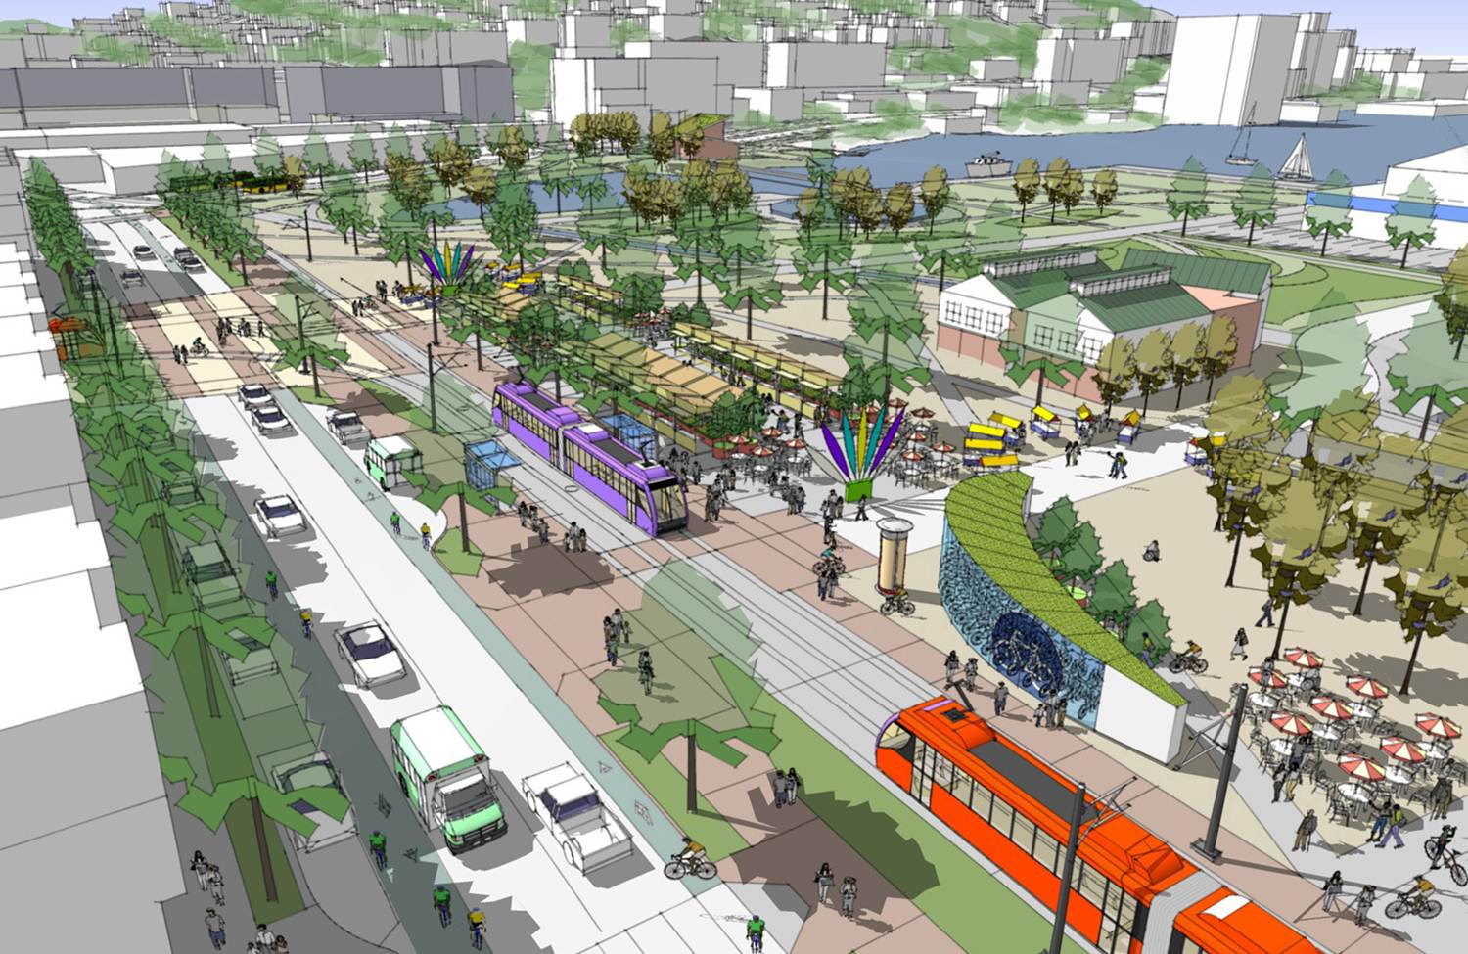
MCSC History: SLU/Uptown Triangle Mobility Plan
In 2010, commenced planning for the South Lake Union/ Uptown Triangle Mobility Plan
Joint effort sponsored by the SLUCC, Uptown Alliance, SLU Chamber of Commerce, and Greater Queen Anne Chamber of Commerce
Package of nearly 60 recommendations to improve mobility in neighborhoods
Most have been completed
Notes:
Our next adventure was the SLU/Uptown Triangle Mobility Plan, launched in 2010.
Go this this slide and next

Slide 5
Excerpt from SLU/Uptown Triangle Mobility Plan
Notes:
The Mobility Plan is where the stakeholders worked with the City, King County Metro and the WSDOT to determine the preferred function of various streets, particularly the new grid of streets that cross 7th Avenue (formerly part of SR 99).
Harrison Street should be the workhorse for vehicular traffic, including future east-west transit that might connect SLU and the Seattle Center. It is were the on and off-ramps to SR 99 Connect, and retained its 4 vehicles lanes.
Thomas Street should be prioritized for pedestrians and bikes, and that has been a focus of its design as a Green Street and Greenway, and incorporated into plans such as Lake2Bay and as the major pedestrian route to the new Arena.
John Street is a local street, but also recognized that it is needed to serve trucks since it has fewer physical barriers than routes that use Harrison Street.
As noted above, most of the nearly 60 recommendations from that Mobility Plan have been completed or incorporated into transportation projects.

Slide 6
MCSC History: SR 99 North Access and Surface Streets Projects (2008 thru 2020)
Continuously engaged with WSDOT to influence design and construction mitigation for North Access and North Surface Streets projects
Notes:
Since the beginning, the Mercer Stakeholders have engaged with WSDOT to influence design of the new SR 99 Tunnel, the North Access (which are the ramps that connect SR 99 to the neighborhood) and most recently the North Surface Streets project (which is nearly done, but on pause with Covid-19 social distancing requirements).
The group has provided input on everything from lane configuration, traffic control, signage and construction sequencing.

Slide 7
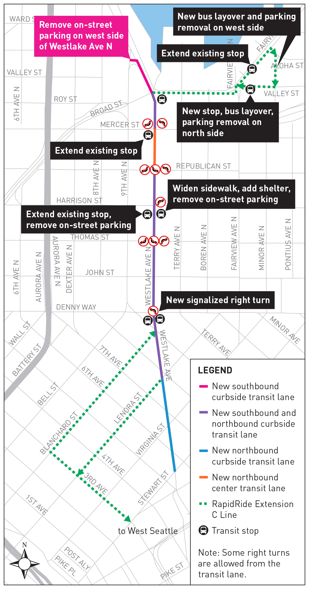
MCSC History: Westlake Transit Lanes (2016)
Facilitated stakeholder meetings with SDOT and King County Metro to influence design of Westlake Transit Lanes
Reviewed City plans and operations protocols
Notes:
In 2016, when King County Metro and SDOT planned to put the transit-only lanes on Westlake Avenue N, they came to the Mercer Stakeholders as the best way to reach the employers and businesses along that corridor. We helped determine the best locations for stops, and where parking and loading zones would be best.

Slide 8
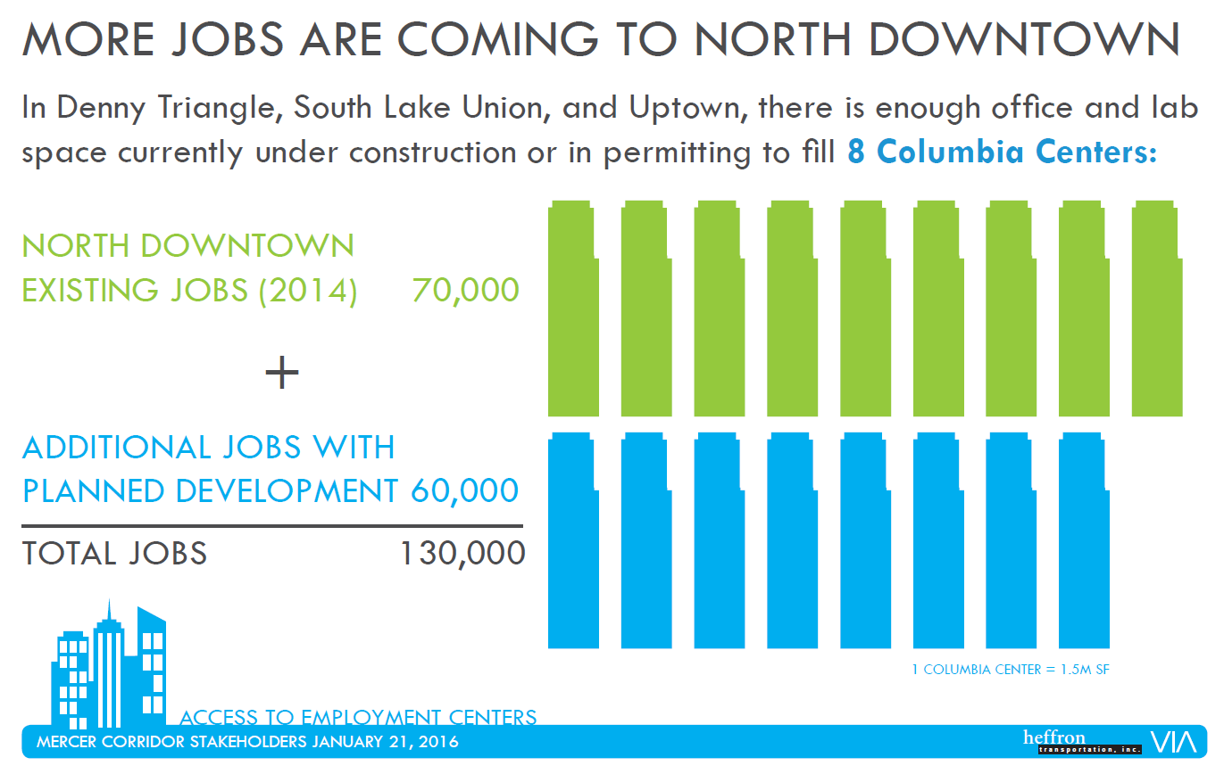
MCSC History: ST3 Advocacy (2016/2017)
Advocated for three stations in north downtown neighborhoods instead of the two stations in ST’s original Plan
Provided research about planned growth in neighborhood and best practices for station spacing
Notes:
Our last big effort was to review and advocate for the neighborhood when Sound Transit was planning the Ballard Link Extension as part of its ST3 bond measure.
The original plan for ST3 had just two stations in North Downtown: one in South Lake Union and the other at Seattle Center.
NEXT SLIDE

Slide 9
Excerpts from ST3 Package
Notes:
We provided the Sound Transit staff and Board with research about the future growth planned for the neighborhood, which we showed would be the second highest density in their system. We showed that these neighborhoods should be considered an extension of the downtown core, with station spacing appropriate for the coming density.
NEXT SLIDE

Slide 10
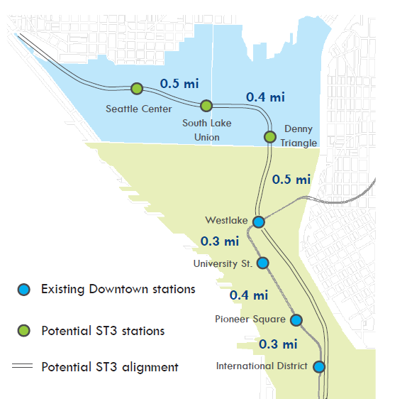
ST3 Advocacy
Extra station is included in the Ballard Extension project
Notes:
Ultimately, the Board agreed, and there are now 3 stations planned in the North Downtown area.
Pause and see if there are any Questions or Comments about past efforts.

Slide 11
Future Projects and Policies
Projects | Policies
Sound Transit Ballard Link Extension | Transportation Budget Deficit
SR 520 Transit Pathways | Private Shuttle Policies
Roosevelt Rapid Ride (J Line) | Curb Management
NODO Map / Seattle Center Arena | Camera Enforcement
1st Avenue Streetcar | TNC Tax
Downtown Street Network Study
Active transportation improvements
Notes:
The list of Mercer Stakeholder accomplishments in the past 14 years is impressive.
And it was all done with an Ad Hoc committee that operates independent of City government.
The fact that initial efforts were Consensus-based made this group very influential. And without the infighting, also allowed the neighborhood to support and then win two Federal grants for Mercer Street, and many other improvements.
But, there is still more to be built in this next decade, and many more challenges coming in this decade.
Here is a list of projects and policies.

Slide 12
Discussion: Future of MCSC
What are your transportation priorities?
What do you like about past MCSC engagement efforts? What keeps you interested?
What would you change?
Meeting logistics and timing?
Schedule of meeting – When needed or regular
Time of day
Location
Notes:
I want to open it up for discussion. Given the number of folks in the meeting, please raise your virtual hand and we’ll call on you before speaking.

Slide 13
Sound Transit Ballard Link Extension Project
Notes:
The biggest of the future projects in the neighborhood is Sound Transit’s Ballard Link Extension.
The Mercer Stakeholders advocated for three stations before the vote, but there is a lot of planning and design yet to come. We have scheduled Sound Transit to present to the Mercer Stakeholders in early June.
Before that, we thought it would be good to have a set of high level principals to guide those interactions. The Downtown Seattle Association has developed a set of principals that provide a great starting place for this discussion, particularly since the section between Westlake and Seattle Center is considered part of the downtown segment of that line.
Jacqueline Gruber, Director of the Built Environment for DSA will go through those guiding principals, and then at the end, we’ll discuss whether those should be edited or augmented to reflect the needs of North Downtown.

Slide 14
DSA Guiding Principles: Ridership & Access
All six downtown stations must be maintained in the final tunnel design.
Tunnel and station design must anticipate the possibility of future expansions beyond Ballard and West Seattle, but also north from Harrison and east to Madison Valley.
Sound Transit must plan for increased regional demand beyond 2035 by maximizing station capacity with more access points and larger platforms.
Transportation infrastructure like the streetcar should remain in operation throughout construction.
Notes:
Presented by Jacqueline Gruber, Director of the Built Environment for DSA

Slide 15
DSA Guiding Principles: Hubs & Connectivity
Investments must emphasize transit connections to current and future jobs, residential hubs, cultural assets and regional growth centers.
New stations must have high-quality system navigation and visibility at the street level while integrating excellent bus/rail/bike/walk connections.
The Jackson Hub in the Chinatown-International District should become Seattle’s premier transit hub and leverage both public and private investment—specifically incorporating and connecting King Street and Union stations to ensure direct, high- quality, in-station transfers between existing light rail and heavy rail.
The Westlake Hub must be designed with intuitive at-grade and below-grade connections that leverage investments in the public realm as well as downtown’s retail core.

Slide 16
DSA Guiding Principles: Land Use
Sound Transit and the City must work together to maximize employment and housing density on future Sound Transit sites.
Sound Transit and the City must maximize affordable housing opportunities around existing and future stations to ensure increased light rail access for citizens of lower income levels.

Slide 17
DSA Guiding Principles: Efficiencies
Agencies should look for efficiencies by working with private property owners and developers in and around stations to develop stations and access portals.
Agencies should collaborate to identify efficiencies and potential cost-sharing opportunities with other public works projects planned in downtown.

Slide 18
Discussion – Ballard Link Extension
Do you agree with the DSA’s Guiding Principles?
Are there principles that should be added for South Lake Union/Uptown?
Sound Transit will present to MCSC on June 3, 2020 (9 AM)
What do you want to learn about?
Notes:
Go through discussion.
We plan to send out a survey to collection information about your transportation priorities so we can plan meetings that fit your needs.

Slide 19
Next Steps
Member survey to determine priorities
Sound Transit Meeting on June 3rd

